Slide 1

K S INSTITUTE OF TECHNOLOGY
DEPARTMENT OF ARTIFICIAL INTELLIGENCE & MACHINE LEARNING
PROJECT PHASE REVIEW 1- BAI685
PRESENTATION ON
“DATA DRIVEN ELECTRIC VEHICLE RANGE PREDICTION USING ML TECHNIQUES”
(1KS24AI403)
(1KS23AI002)
(1KS24AI401)
(1KS23AI038)
DR. Girish TR
Department of AIML
K.S.I.T
SOUJANYA
ANITA KUMARI
KARUNA SINDHU
REVANTH

Slide 2

INDEX
INTRODUCTION
PROBLEM STATEMENT & OBJECTIVE
LITERATURE SURVEY
DISADVANTAGES OF EXISITING WORK
PROPOSED SOLUTION & OBJECTIVES
SYSTEM DESIGN & ARCHITECTURE
SYSTEM FLOWCHART
PROPOSED SYSTEM & ALGORITHM
PROGRESS ACHIEVED
WORK PLAN
PROJECT OUTCOME
ADVANTAGES OF PROPOSED SYSTEM
APPLICATIONS OF PROPOSED SYSTEM
CONCLUSION
REFERENCES

Slide 3
INTRODUCTION
Electric Vehicles (EVs) are vehicles that run fully or partially on electricity instead of conventional fuels like petrol or diesel. They use electric motors for propulsion and store energy in rechargeable battery packs. EVs are considered environmentally friendly due to lower emissions and higher energy efficiency.
Types of EVs: - BEV (Battery Electric Vehicle) - PHEV (Plug-in Hybrid Electric Vehicle) - HEV (Hybrid Electric Vehicle) - FCEV (Fuel Cell Electric Vehicle)
3

Slide 4
PROBLEM STATEMENT & OBJECTIVE
Problem Statement
Electric vehicle drivers face uncertainty about their remaining range due to multiple factors affecting
battery consumption. Traditional range estimators often fail to account for real-time conditions such as
temperature, driving style, terrain, and HVAC usage, leading to range anxiety and suboptimal trip planning.
Objective
Develop a highly accurate ML model for EV range prediction (target Mean Absolute Error < 5 km)
Create a comprehensive synthetic dataset with realistic physics-based relationships
Build an intuitive web interface for real-time range estimation
Provide RESTful API for integration with other systems
Achieve model interpretability to understand key factors affecting range
Ensure battery safety → prevent overcharge, overheating
Measure data → voltage, current, temperature (sensors)
Estimate SOC & SOH → know charge level and health
Improve performance & efficiency → optimize usage
Check operating limits → keep battery within safe range
Apply control logic → make decisions based on data
4

Slide 5
LITERATURE SURVEY
S.No | Title of the paper | Author | Name of the Journal and Publication Year of the Paper | Methodology | Drawback
1 | Electric Vehicle Range Prediction Models | S. Kumar et al. | World Electric Vehicle Journal, 2025 | Comprehensive review of ML, mathematical, and simulation-based range prediction models; | Lacks experimental validation; mostly theoretical comparison
2 | A Review for Remaining Driving Range Prediction of Electric Vehicles Using Machine Learning Algorithms | Y. Zhang et al. | Journal of Data Science and Intelligent Systems, 2025 | Reviews ML algorithms such as SVM, ANN, and deep learning for predicting | Limited discussion on real-time implementation challenges
3 | A Novel Data-Driven Framework for Driving Range Prognostics in Electric Vehicles | H. Liu et al. | Engineering Applications of Artificial Intelligence, 2025 | Hybrid model using LSTM for speed prediction and LightGBM for energy consumption | Requires large datasets and high computational power

Slide 6
LITERATURE SURVEY
S.No | Title of the paper | Author | Name of the Journal and Publication Year of the Paper | Methodology | Drawback
1 | Power Prediction for Electric Vehicles Using Online Machine Learning | M. Alshahrani et al. | IEEE Transactions on Smart Grid, 2021 | Applies recurrent neural networks (RNN) to predict battery SOC and range for smart charging optimization | Model complexity and overfitting issues
2 | Data-Driven Prediction of Route-Level Energy Use for Electric Vehicle Fleets | K. McCarthy et al. | IEEE Transactions on Intelligent Transportation Systems, 2020 | Combines regression, decision trees, and neural networks for fleet-level energy prediction using multi-source data | Less effective for individual vehicle-level prediction
3 | Machine Learning-Based Energy Consumption Prediction for Electric Vehicles | P. B. Nair et al. | Applied Energy, 2019 | Uses Random Forest and Gradient Boosting for predicting EV energy consumption based on driving | Model performance decreases with unseen driving conditions

Slide 7
DISADVANTAGES OF EXISITING WORK
High system complexity
Poor thermal management
Limited scalability
Communication delays
High cost
Weak fault detection
Energy inefficiency
Security issues
Frequent calibration required
7

Slide 8

PROPOSED SOLUTION & OBJECTIVE
Proposed Solution
The system collects real-time and historical data from the EV and external sources, processes it, and applies a trained machine learning model to estimate the remaining range.
This project addresses the challenge by developing a data-driven machine learning model that considers 11 comprehensive parameters including battery state, environmental conditions, driving patterns, and vehicle load. The model learns complex non-linear relationships between these factors and provides accurate range predictions through an intuitive web interface.
Input Parameters
The prediction model uses multiple influencing factors:
Vehicle Parameters
Speed
weather
Traffic
Design style

Slide 9
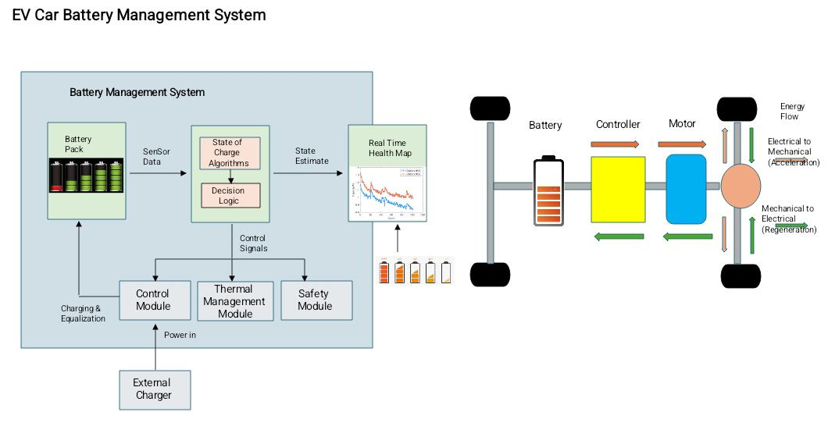
SYSTEM DESIGN

Slide 10
SYSTEM ARCHITECTURE
System Architecture
Layer 1 – Input Layer
User opens the web interface in their browser.
User adjusts 11 vehicle parameters using sliders and dropdowns.
Input data includes battery level, temperature, speed, weather, drive mode, and other factors.
Layer 2 – Data Processing Layer
Web application collects all input parameters.
Data is validated and formatted into a structured format.
Input values are sent to the backend server via REST API.
Layer 3 – AI Processing Layer
Machine Learning model receives the input data.
Preprocessing pipeline normalizes numerical features and encodes categorical features.
Gradient Boosting model (200 decision trees) analyzes all parameters.
Model predicts the remaining driving range with 80%+ accuracy.
Layer 4 – Output Layer
Predicted range is calculated in kilometers and miles.
Results are sent back to the web interface.
User sees the predicted range displayed on screen.
7

Slide 11

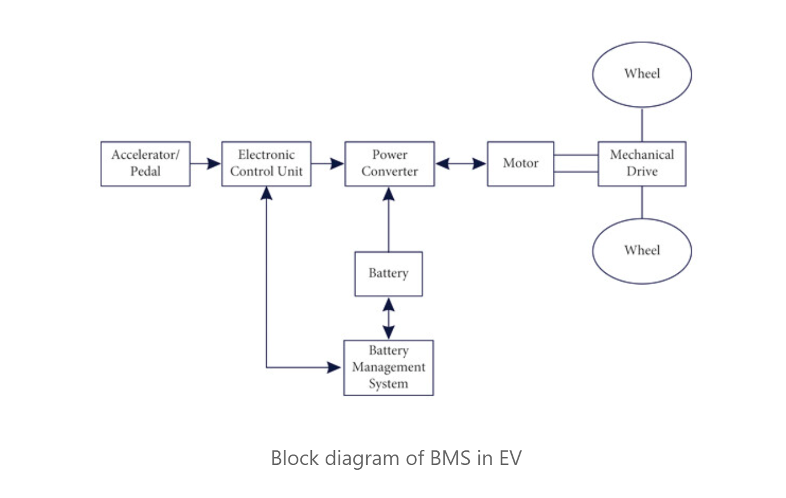
FLOWCHART

Slide 12
PROPOSED SYSTEM & ALGORITHM
Machine Learning Model
Algorithm Selection
The system uses a Gradient Boosting Regressor from scikit-learn. This algorithm was chosen for several key reasons: • Handles non-linear relationships between features effectively • Captures complex interactions (e.g., temperature × speed effects) • Robust to outliers and missing data • Provides feature importance metrics for interpretability • Excellent performance on tabular data • No need for extensive feature scaling (though we still apply it for consistency)

Slide 13
PROPOSED SYSTEM & ALGORITHM
Model Hyperparameters
n_estimators: 200 Number of boosting stages. More trees improve accuracy but increase training time.
learning_rate: 0.1 Shrinks contribution of each tree. Lower values require more trees but improve generalization.
max_depth: 5 Maximum depth of individual trees. Controls model complexity and overfitting.
min_samples_split: 5 Minimum samples required to split an internal node. Prevents overfitting.
min_samples_leaf: 2 Minimum samples required at leaf node. Smooths predictions.
subsample: 0.8 Fraction of samples used for fitting trees. Adds randomness and prevents overfitting.
random_state: 42 Ensures reproducibility across runs.

Slide 14
PROPOSED SYSTEM & ALGORITHM
Feature Engineering
The model uses a preprocessing pipeline that handles both numerical and categorical features:
Numerical Features (8 total): Standardized using StandardScaler to have mean=0 and std=1. This ensures all features contribute equally to the model and improves convergence.
Categorical Features (3 total): Encoded using OneHotEncoder, creating binary columns for each category. The encoder handles unknown categories gracefully during prediction.
Training Process
Data is split into 80% training and 20% test sets using train_test_split
Preprocessing pipeline is fitted on training data only (prevents data leakage)
Gradient Boosting builds trees sequentially, each correcting errors of previous trees
Training takes approximately 10-30 seconds on modern hardware
Model and preprocessing pipeline are saved together for consistent inference

Slide 15
PROJECT PROGRESS
Progress Achieved
Work Completed So Far
Literature Survey Completed Recent research papers on car ev battery management system were studied to identify suitable methods and research gaps in range prediction.
Problem and System Design Completed The problem statement, objectives, system architecture, block diagram, and workflow have been finalized.
Dataset Preparation Completed Real time data has been collated from online sources and organized into separate categories.
Algorithm Selection Completed trying various algorithm to train ai model which result in higher accuracy percentage has been verified.
Prototype Development Started Model training has been started to check and analyze accuracy percentage.
In parallel backend logic and ui development has been started.
8

Slide 16
WORK PLAN
Work Plan
Phase | Activity | Status
1 | Literature survey and problem identification | Completed
2 | Problem statement, objectives and system design | Completed
3 | Data Collection and Preparation | Completed
4 | Algorithm Selection(Gradient boost regression) | Completed
5 | AI/ML model training and testing | Completed
6 | AI + Front end Ui integration | Started
7 | Testing, accuracy evaluation and improvements | To be completed
8 | Final prototype, documentation and presentation | To be completed
12

Slide 17
PROJECT OUTCOME
Expected Outcomes
Reduces range anxiety for EV drivers through accurate predictions
Enables better trip planning with real-time range estimates
Demonstrates AI/ML capabilities in automotive applications
Ready for integration into vehicle systems or mobile applications
13

Slide 18

ADVANTAGES OF PROPOSED SYSTEM
Advantages
Higher accuracy compared to traditional models
Supports real-time prediction
Scalable for different EV types
Adapts to real-world driving conditions

Slide 19
APPLICATIONS OF PROPOSED SYSTEM
Used in electric vehicles (EVs) to predict remaining driving range
Helps reduce range anxiety for drivers
Improves battery management system (BMS) performance
Supports smart charging stations for efficient power usage
Useful in public transportation systems (electric buses, taxis)

Slide 20
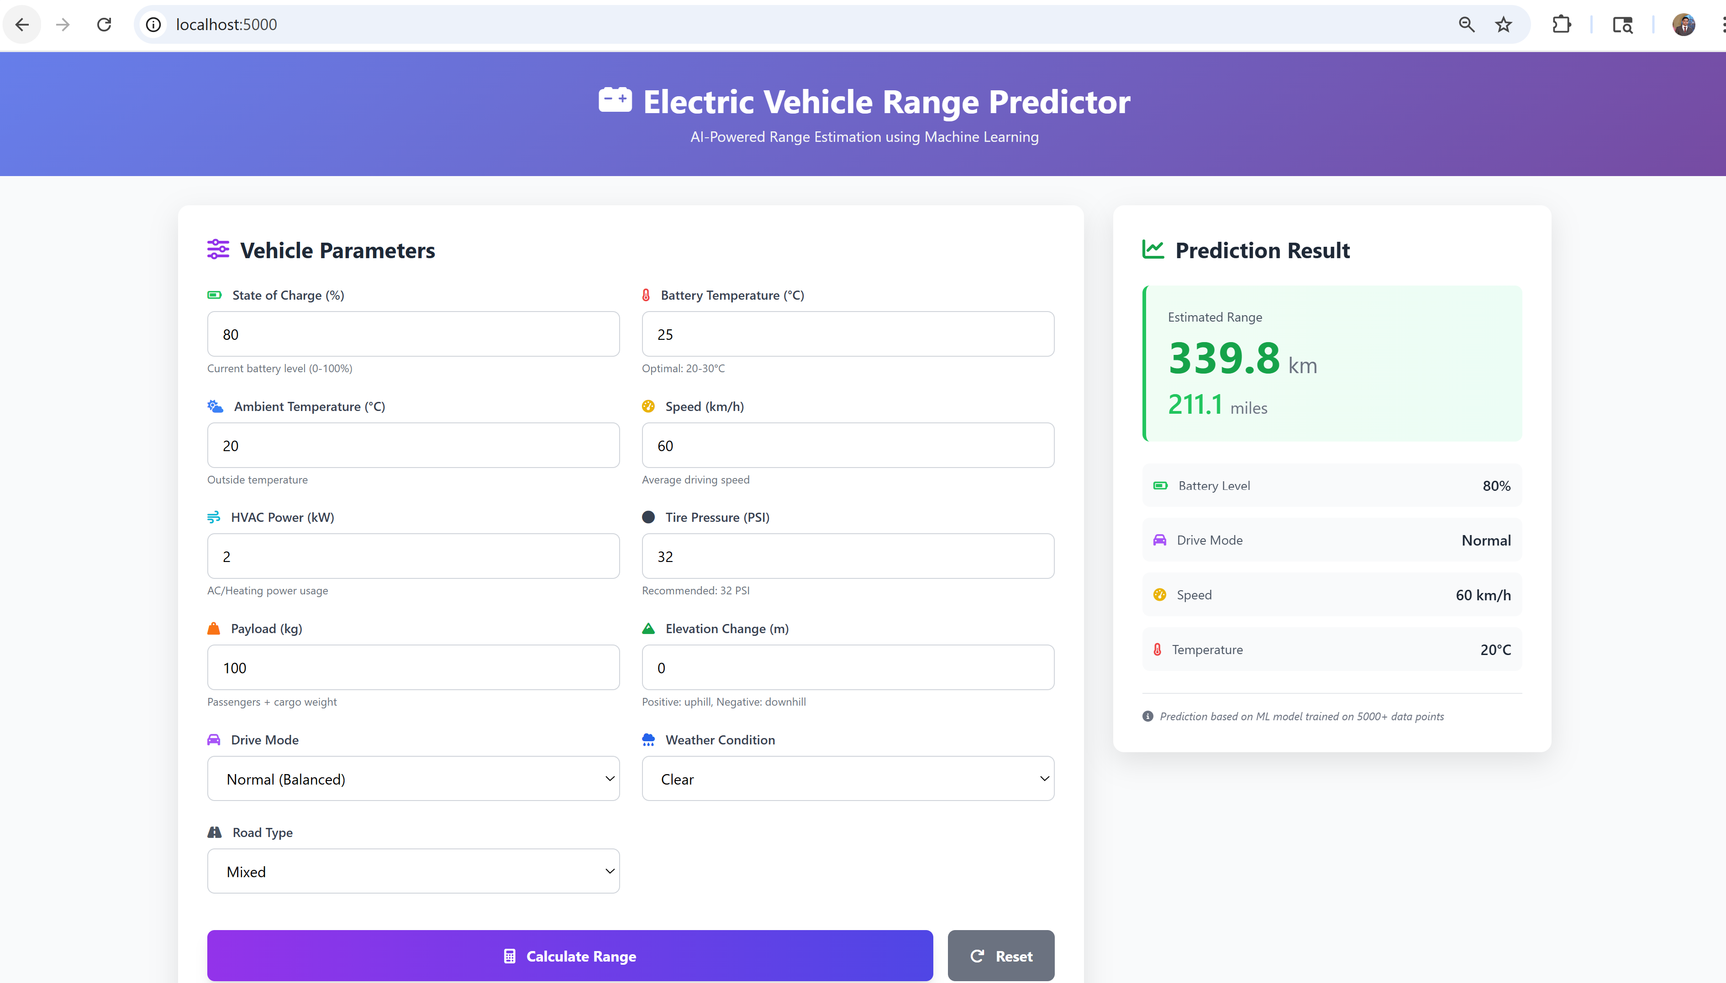
APPLICATION PROPOSED

Slide 21
CONCLUSION
A data-driven approach using machine learning provides accurate prediction of EV driving range
The system effectively utilizes vehicle, battery, and environmental data for better estimation
Machine learning models such as Random Forest, Gradient Boosting, and LSTM improve prediction performance compared to traditional methods

Slide 22
REFERENCES
V Praveen, P Hari Manohara Varma, BVSSN Raju, “Image Encryption using Scan Patterns and Hill Cipher”, IEEE International Conference on Recent Trendsin Electronics, Information & Communication Technology (RTEICT-2018), pp.1-6,2018.
Sara Farrag, Wassim Alexan, Hisham H. Hussein, “Triple-Layer Image Security Using a Zigzag Embedding Pattern”, pp-1-8,2019.
Krishna Raj A ,Sharath Chandra N R, “ Image encryption and decryption using Scan pattern and XTEA
encryption algorithm”. IOSR Journal of Electronics and Communication Engineering (IOSR-JECE),vol. 13, pp.
65-71,2018.
Veena G and Dr. Ramakrishna M,“A Survey on Image Encryption using Chaos- based Techniques”, IJACSA, Vol.12, pp.379-384, 2021

Slide 23



